Slide 1


Slide 2
RNN Encoder-Decoder
Rackhun Son
Mar 7, 2019

Slide 3
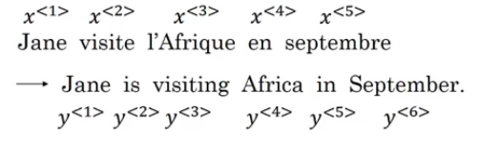
Sequence-to-Sequence
Sequence
일련의 시계열 데이터를 늘어놓은 것.
모델의 출력물이 시퀀스 형태 sequence-to-sequence 모델이라고 한다. 예) 질문/답변 형식의 글, 영어→프랑스어 번역문
https://www.analyticsvidhya.com/blog/2019/01/sequence-models-deeplearning/

Slide 4
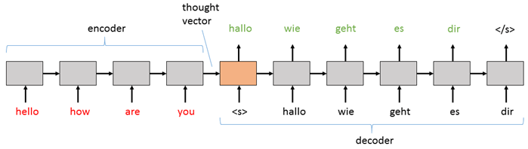
Sequence-to-Sequence
Encoder-Decoder
인코더(Encoder)는 입력 데이터를 처리하고, 디코더(Decoder)가 출력데이터를 생성한다.
디코더는 자신의 출력을 다음스텝의 입력값으로 받는다.
https://www.microsoft.com/en-us/cognitive-toolkit/blog/2016/11/sequence-to-sequence-deep-recurrent-neural-networks-in-cntk-part-1/

Slide 5
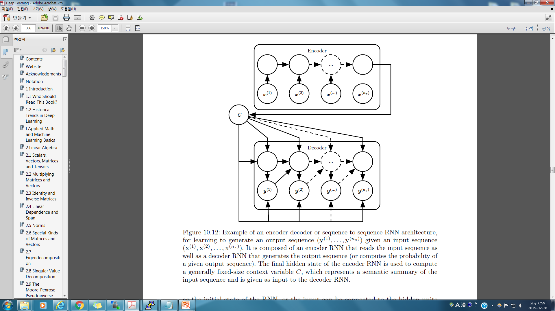
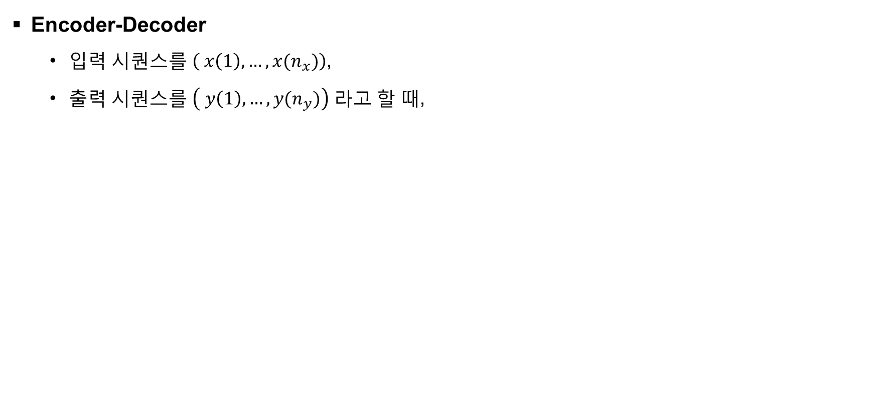
Sequence-to-Sequence
Encoder-Decoder
입력 시퀀스를 $\left( x\left(1\right), …, x(n_{x})\right)$,
출력 시퀀스를 $\left( y\left(1\right), …, y(n_{y})\right)$ 라고 할 때,
Deep Learning, IanGoodfellow, Yoshua Bengio, and Aaron Courville (p.386)

Slide 6
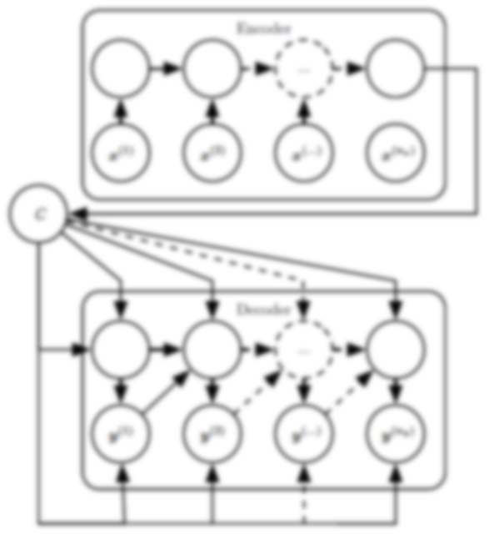
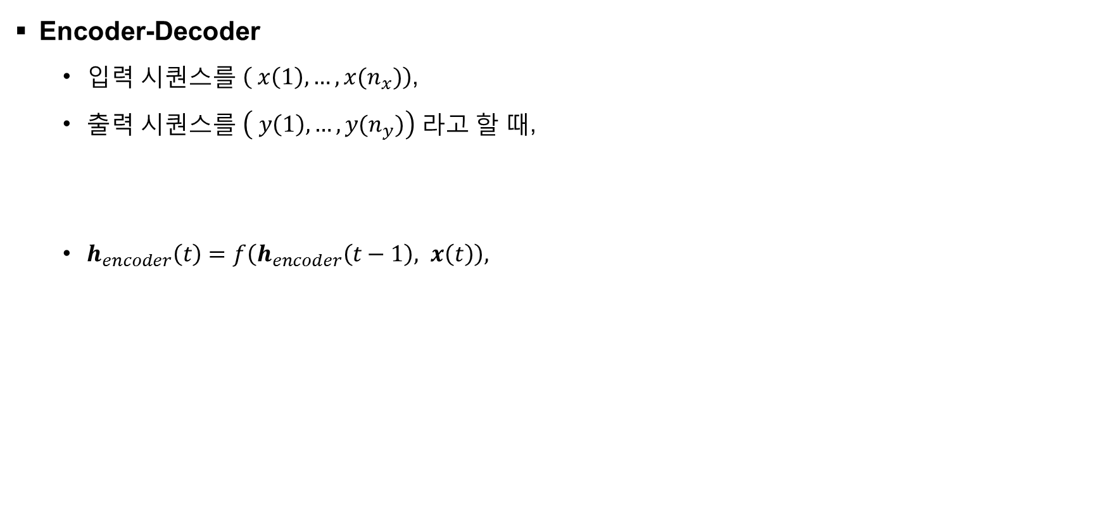
Sequence-to-Sequence
Encoder-Decoder
입력 시퀀스를 $\left( x\left(1\right), …, x(n_{x})\right)$,
출력 시퀀스를 $\left( y\left(1\right), …, y(n_{y})\right)$ 라고 할 때,
$h_{encoder}\left(t\right)=f\left(h_{encoder}\left(t−1\right), x\left(t\right)\right),$
Deep Learning, IanGoodfellow, Yoshua Bengio, and Aaron Courville (p.386)

Slide 7

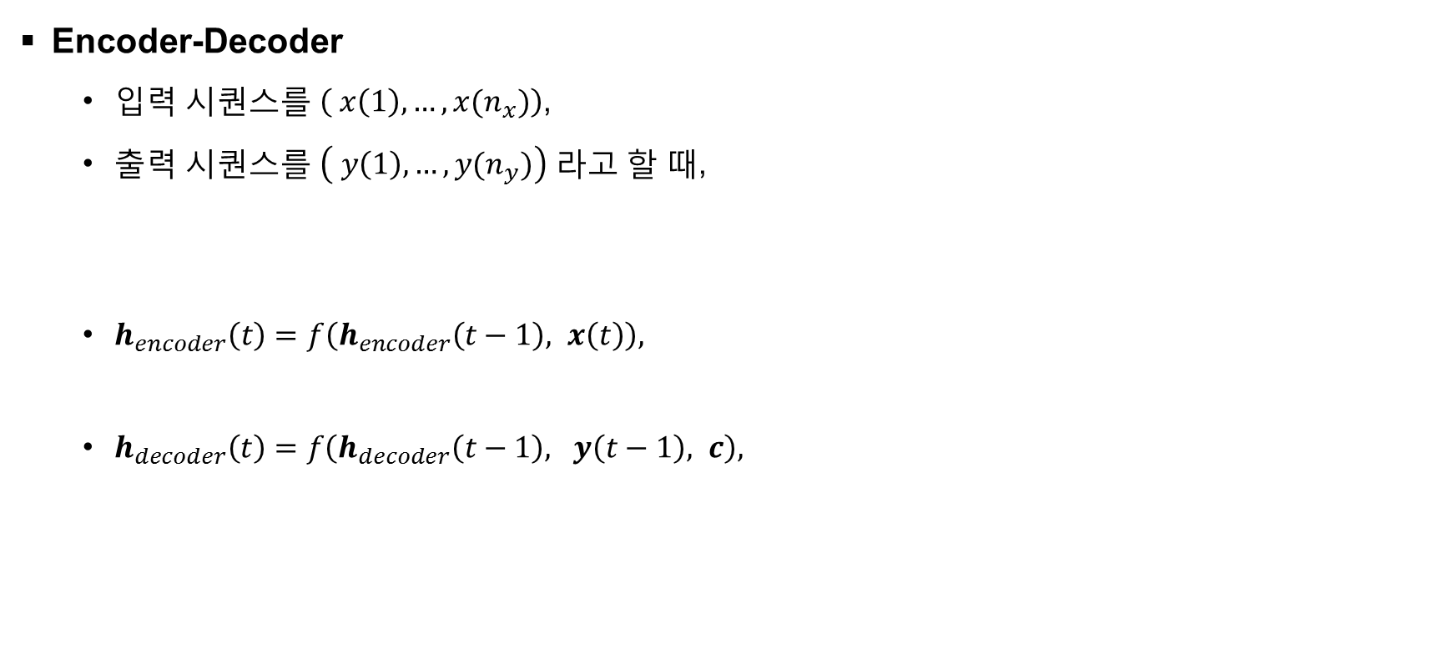
Sequence-to-Sequence
Encoder-Decoder
입력 시퀀스를 $\left( x\left(1\right), …, x(n_{x})\right)$,
출력 시퀀스를 $\left( y\left(1\right), …, y(n_{y})\right)$ 라고 할 때,
$h_{encoder}\left(t\right)=f\left(h_{encoder}\left(t−1\right), x\left(t\right)\right),$
$h_{decoder}\left(t\right)=f\left(h_{decoder}\left(t−1\right), y\left(t−1\right), c\right),$
Deep Learning, IanGoodfellow, Yoshua Bengio, and Aaron Courville (p.386)

Slide 8
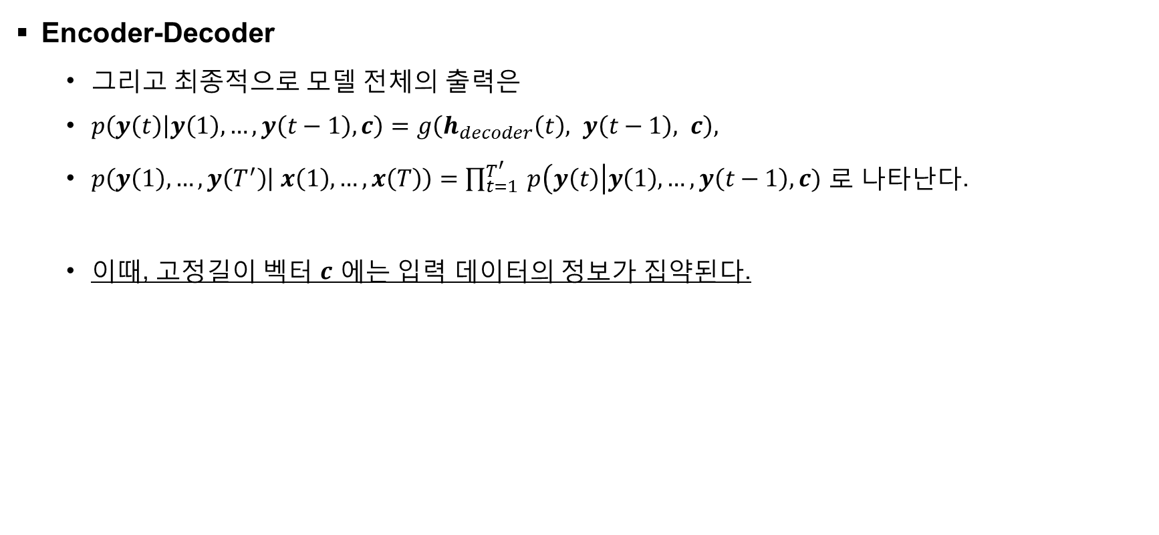
Sequence-to-Sequence
Encoder-Decoder
그리고 최종적으로 모델 전체의 출력은
$p\left(y\left(t\right) | y\left(1\right),…, y\left(t−1\right),c\right)=g\left(h_{decoder}\left(t\right), y\left(t−1\right), c\right),$
$p\left(y\left(1\right),…, y\left(T^{′}\right) | x\left(1\right),…, x\left(T\right)\right)=\prod_{t=1}^{T^{′}}{ p\left(y\left(t\right)\right|y\left(1\right), …, y\left(t−1\right), c)}$ 로 나타난다.
이때, 고정길이 벡터 $c$ 에는 입력 데이터의 정보가 집약된다.
Deep Learning, IanGoodfellow, Yoshua Bengio, and Aaron Courville (p.386)

Slide 9
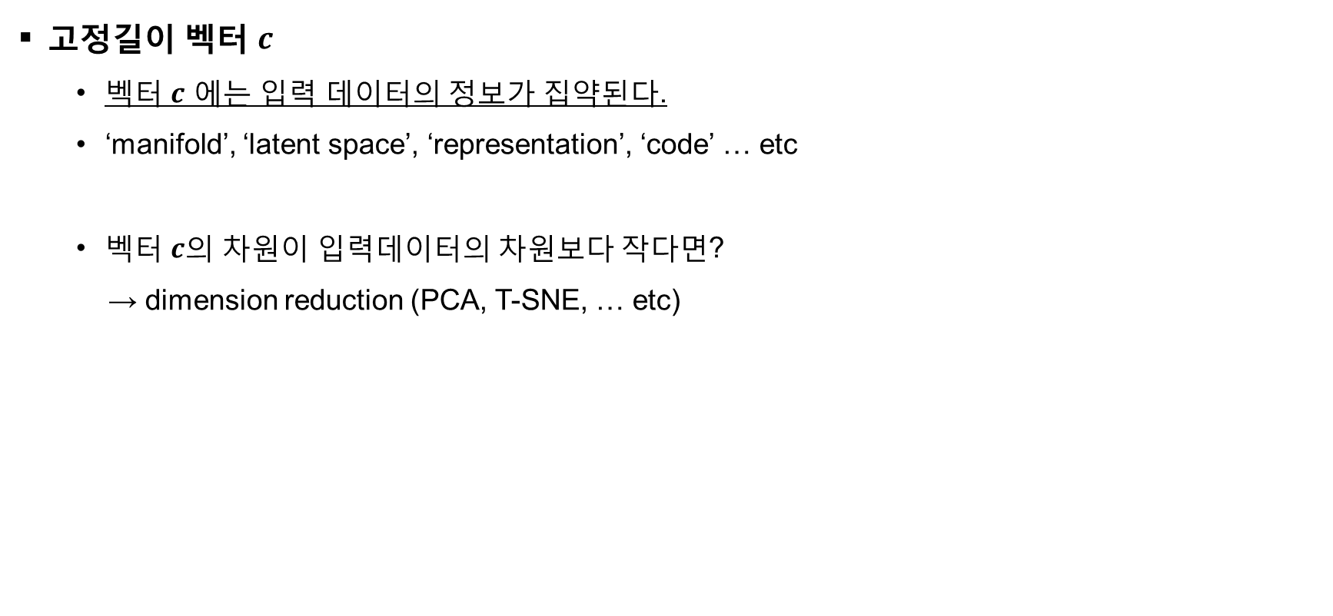
Sequence-to-Sequence
고정길이 벡터 $c$
벡터 $c$ 에는 입력 데이터의 정보가 집약된다.
‘manifold’, ‘latent space’, ‘representation’, ‘code’ … etc
벡터 $c$의 차원이 입력데이터의 차원보다 작다면?
→ dimension reduction (PCA, T-SNE, … etc)
Deep Learning, IanGoodfellow, Yoshua Bengio, and Aaron Courville (p.386)

Slide 10
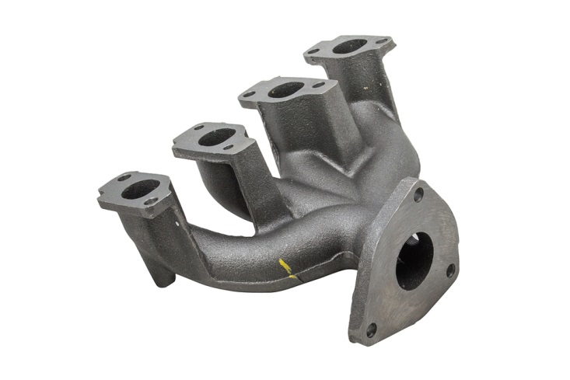
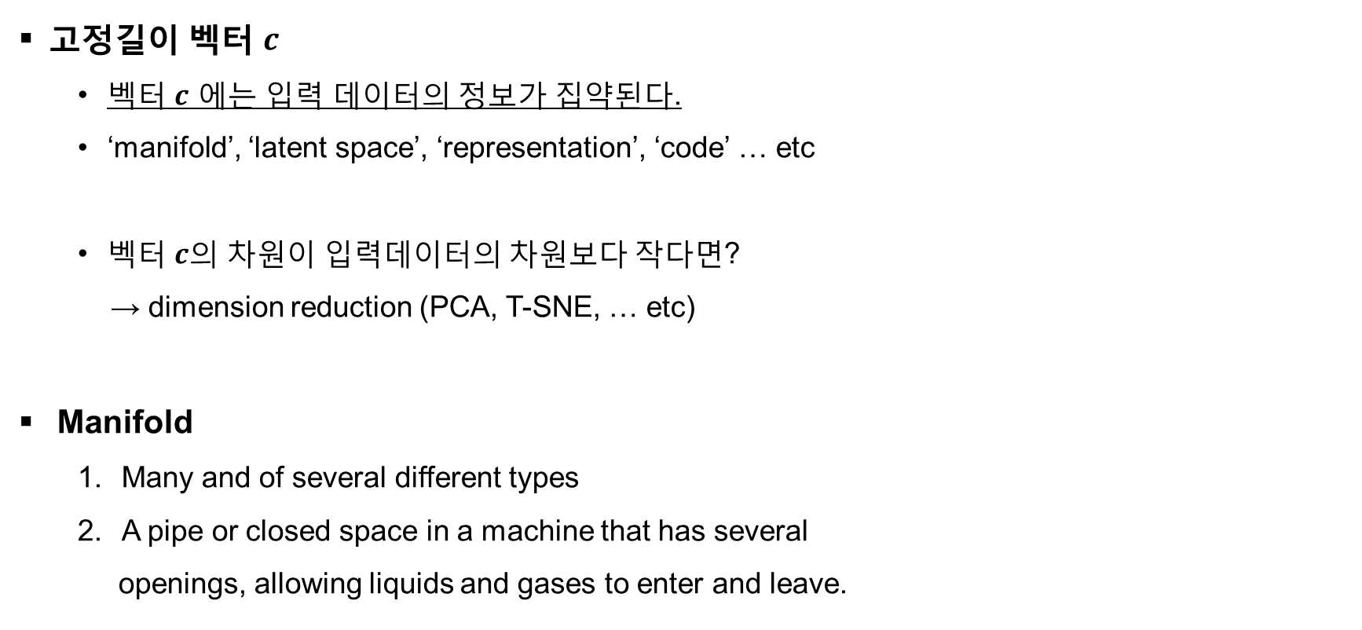
Sequence-to-Sequence
고정길이 벡터 $c$
벡터 $c$ 에는 입력 데이터의 정보가 집약된다.
‘manifold’, ‘latent space’, ‘representation’, ‘code’ … etc
벡터 $c$의 차원이 입력데이터의 차원보다 작다면?
→ dimension reduction (PCA, T-SNE, … etc)
Manifold
Many and of several different types
A pipe or closed space in a machine that has several
openings, allowing liquids and gases to enter and leave.
https://www.yourmechanic.com/article/symptoms-of-a-bad-or-failing-intake-manifold-runner-control

Slide 11
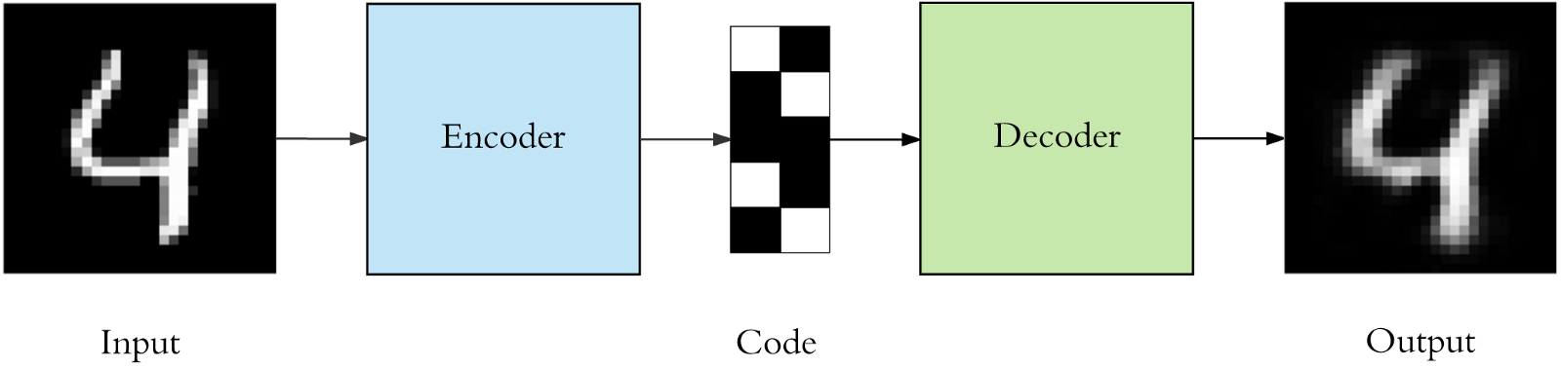
Manifold Visualization
MNIST를 이용한 Auto-encoder 예제
Auto-encoder란 입력값과 출력값이 동일한 encoder-decoder 구조
Code라는 공간에 입력값의 정보가 함축된다.
https://blog.sicara.com/keras-tutorial-content-based-image-retrieval-convolutional-denoising-autoencoder-dc91450cc511

Slide 12
Manifold Visualization
MNIST를 이용한 Auto-encoder 예제
모델구조는 각 2개의 fully-connected layer (h=512)로 구성
Manifold는 2차원으로 구성
Manifold
Encoder
Decoder
Input
Output

Slide 13
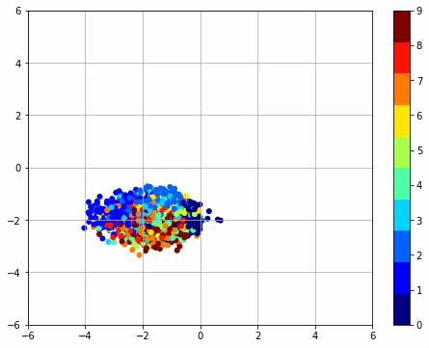
Manifold Visualization
MNIST 모델학습에 따른 Manifold의 변화과정
https://github.com/hwalsuklee/tensorflow-mnist-VAE

Slide 14
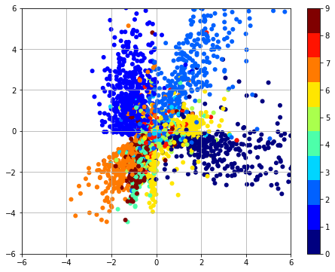
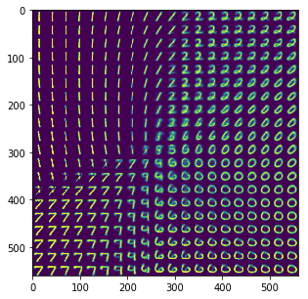
Manifold Visualization
Manifold 학습결과
https://github.com/hwalsuklee/tensorflow-mnist-VAE

Slide 15
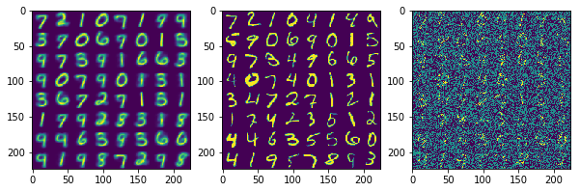
Manifold Visualization
Manifold 학습결과
Manifold
Output
Ground Truth
Input
https://github.com/hwalsuklee/tensorflow-mnist-VAE

Slide 16
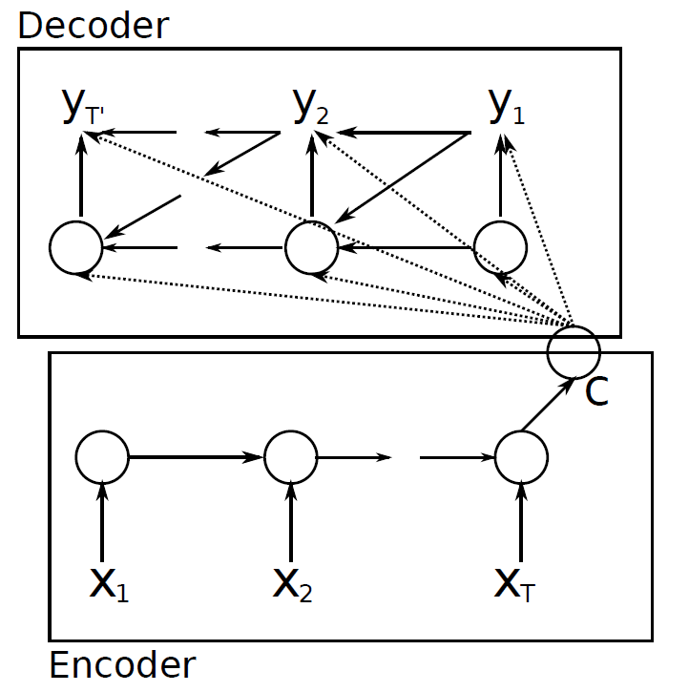
Phrase Representations using RNN Encoder-Decoder (Cho et al, 2014)
Model architecture
Machine Translation using RNN Encoder-Decoder (English → French).

Slide 17
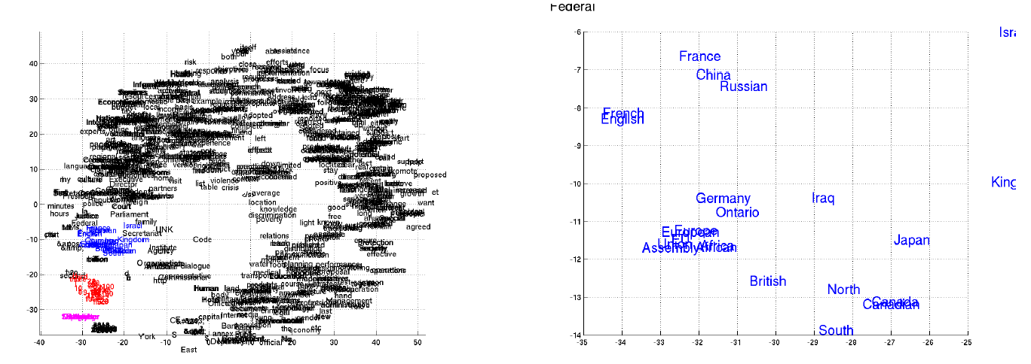
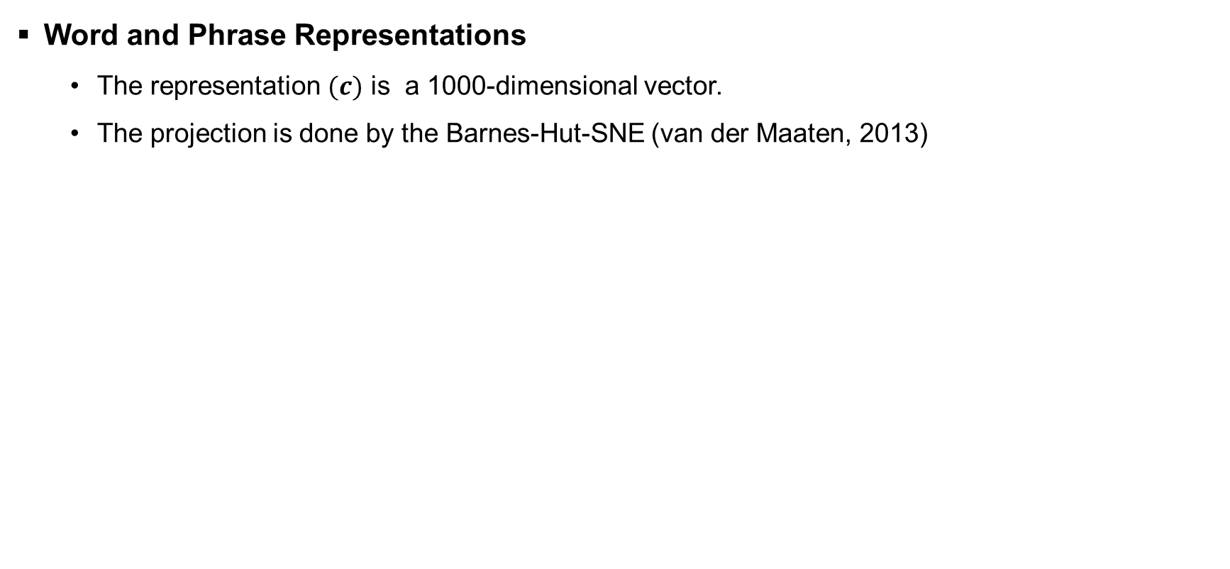
Phrase Representations using RNN Encoder-Decoder (Cho et al, 2014)
Word and Phrase Representations
The representation $(c)$ is a 1000-dimensional vector.
The projection is done by the Barnes-Hut-SNE (van der Maaten, 2013)

Slide 18
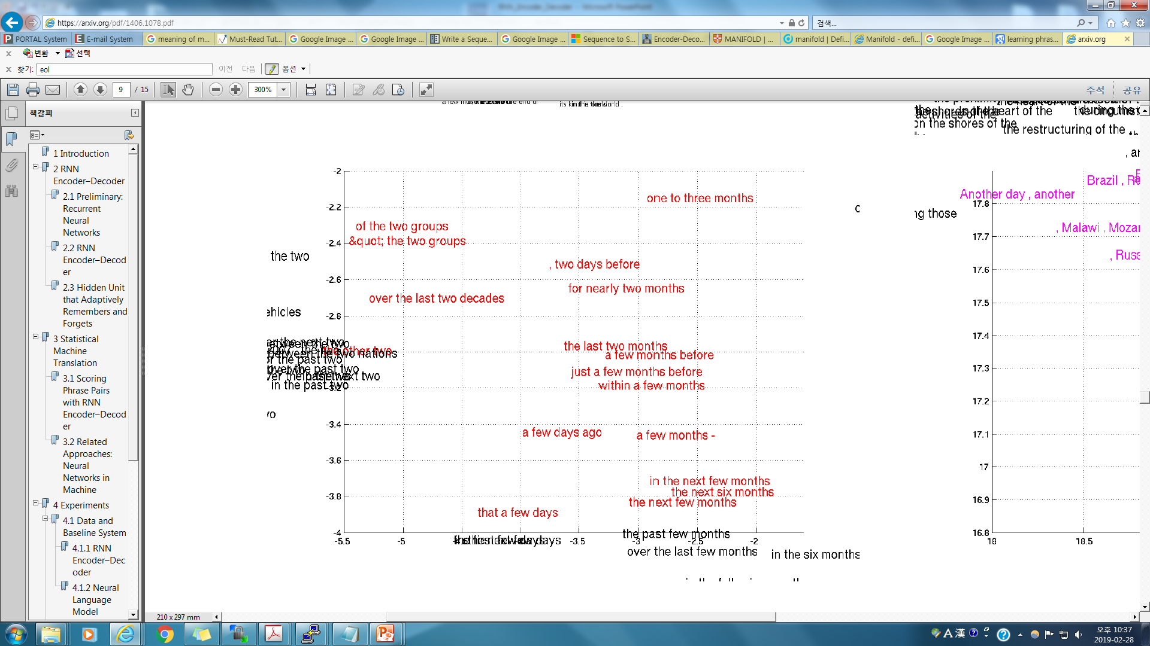
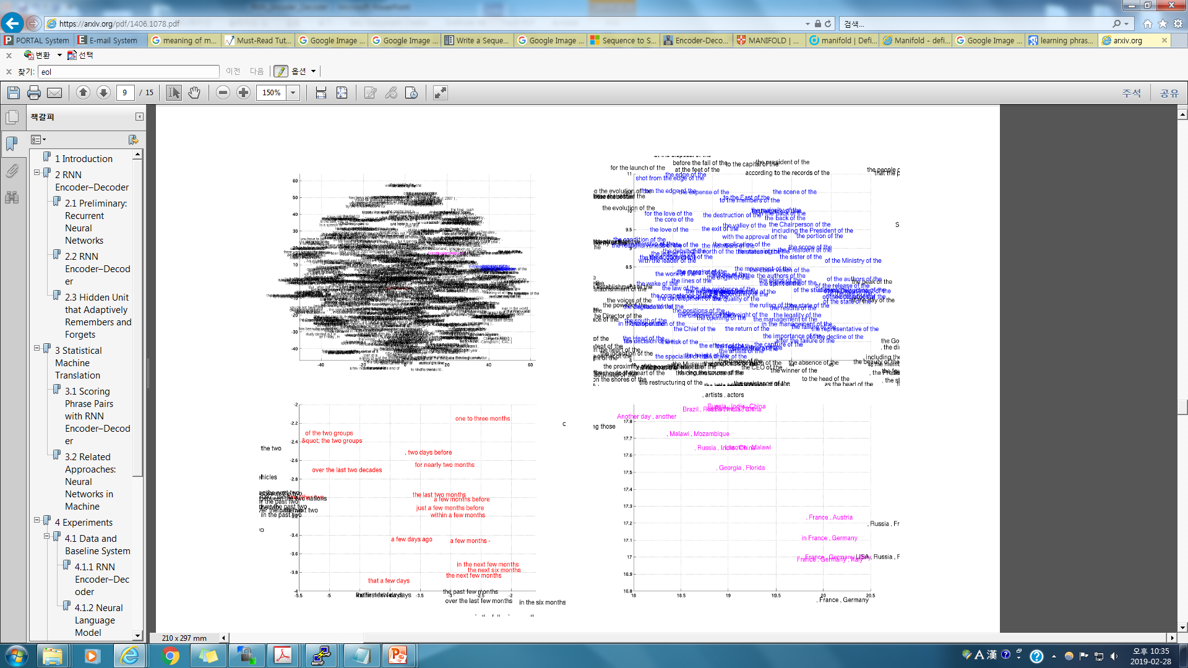
Phrase Representations using RNN Encoder-Decoder (Cho et al, 2014)

Slide 19
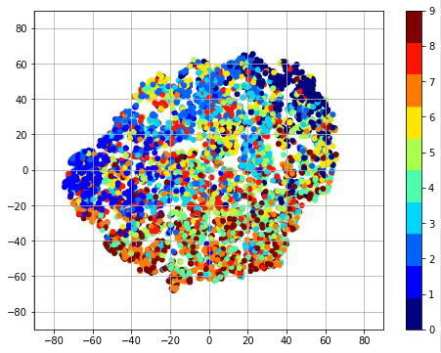
Manifold Visualization
MNIST 모델 학습에 따른 변화 Manifold with 50-dimensional vector..
https://github.com/hwalsuklee/tensorflow-mnist-VAE

Slide 20
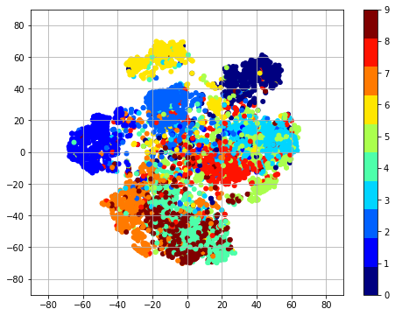
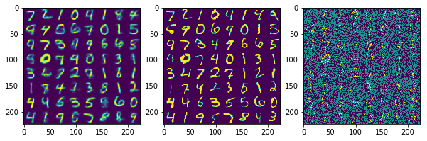
Manifold Visualization
Manifold 학습결과
Manifold
Output
Ground Truth
Input
https://github.com/hwalsuklee/tensorflow-mnist-VAE

Slide 21
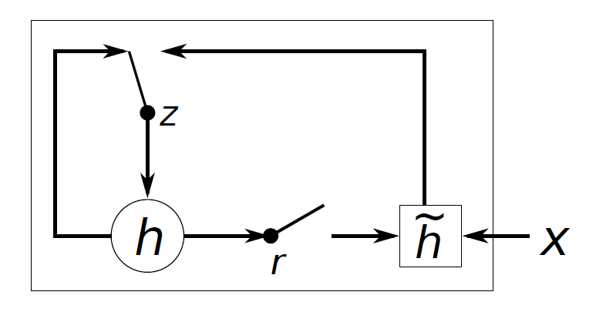
Phrase Representations using RNN Encoder-Decoder (Cho et al, 2014)
Hidden Unit that Adaptively Remembers and Forgets
Machine Translation using RNN Encoder-Decoder (English → French).

Slide 22
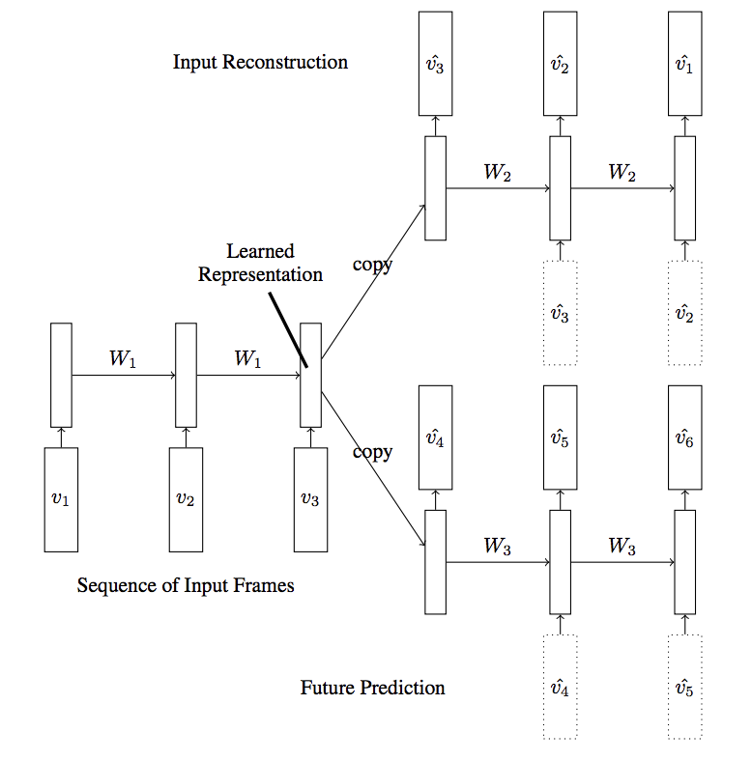
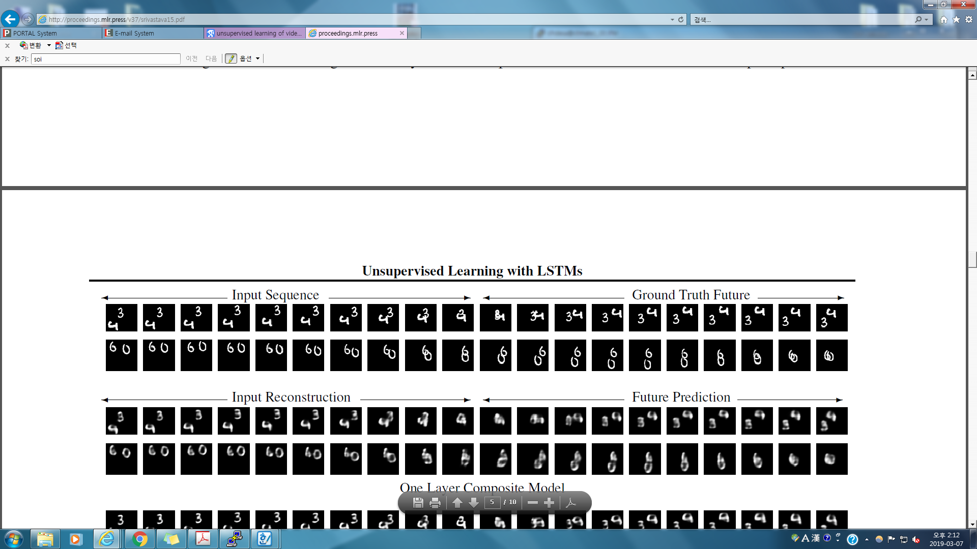
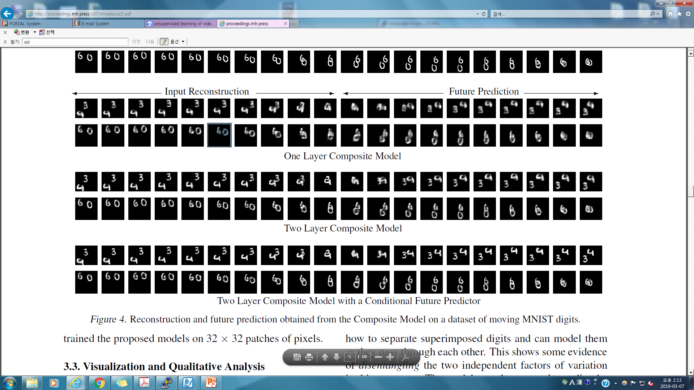
Video Representation using LSTMs (Scrivastava et al, 2015)

Slide 23
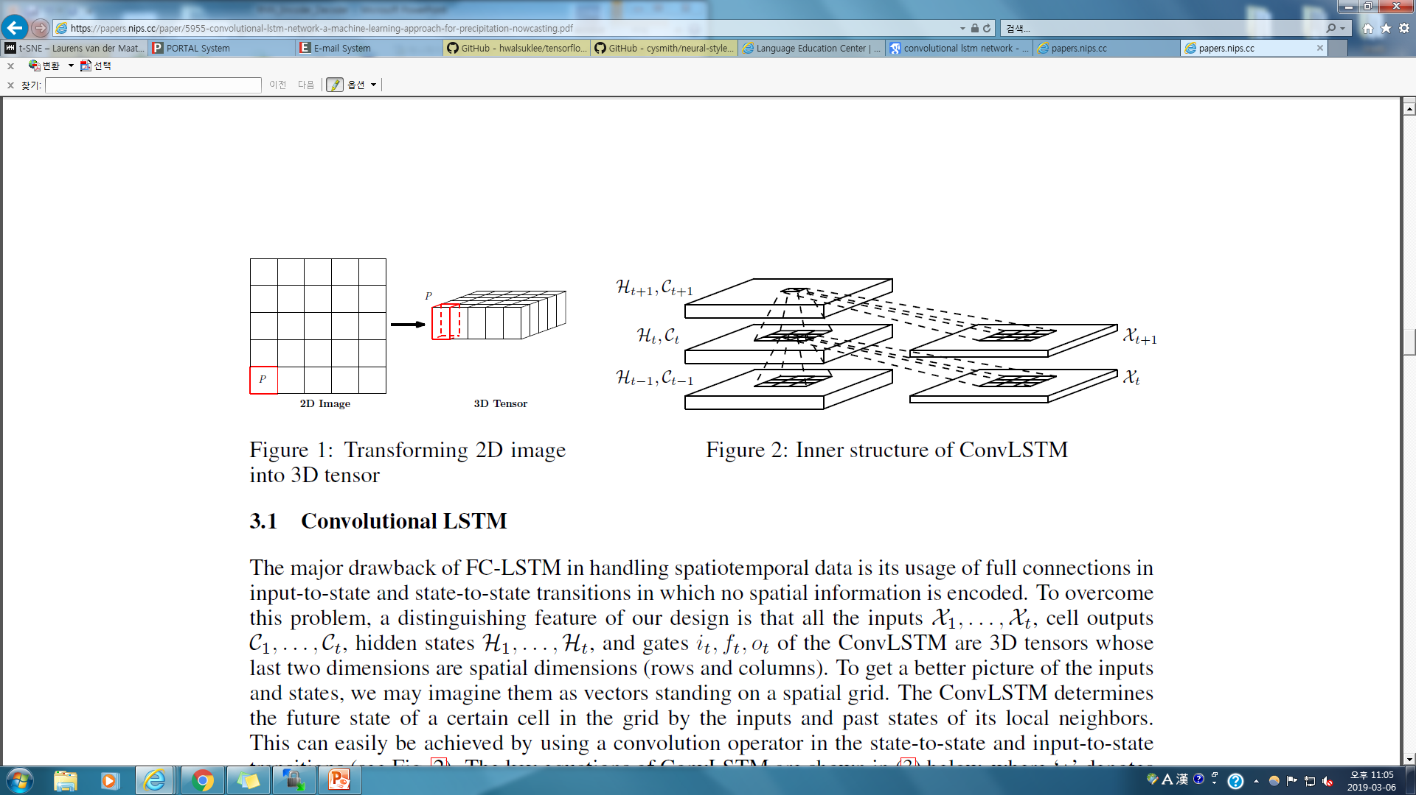
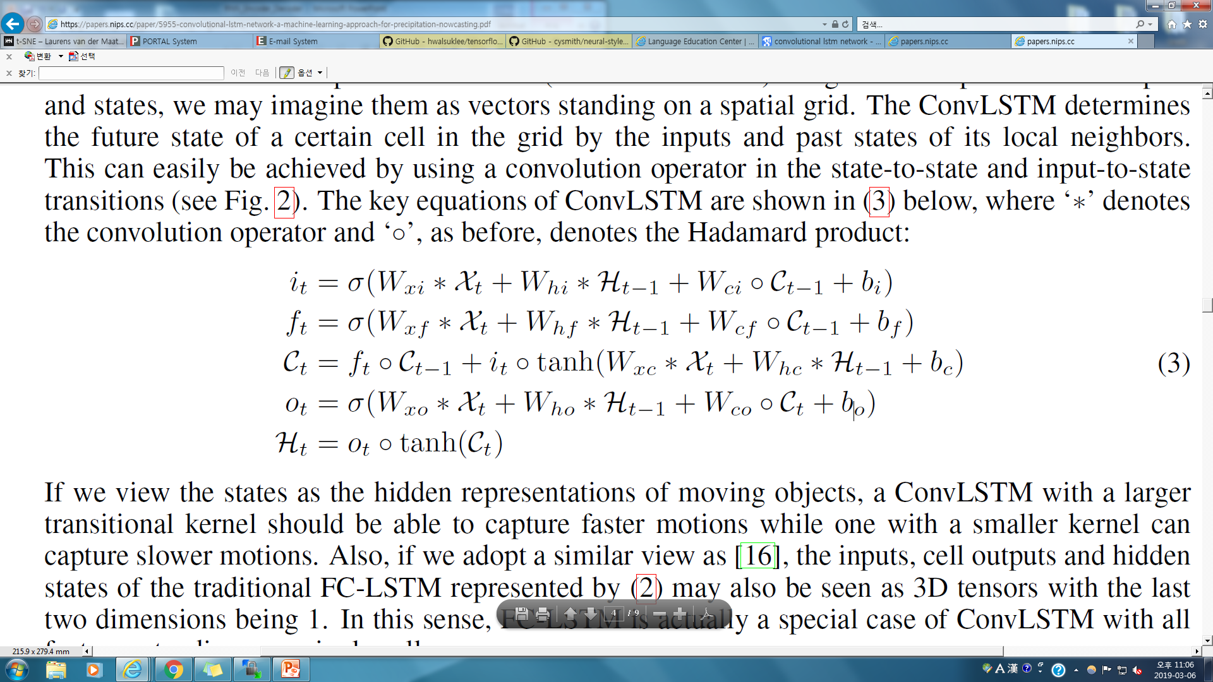
Convolutional LSTM Network (Xingjian et al, 2015)

Slide 24

Acknowledgment
참고문헌
스고모리 유우스케, “정석으로 배우는 딥러닝“, 위키북스
K. Cho. B. Merrienboer, C.Gulcehre, F. Bougares, H. Schwenk, and Y. Bengio. Learning phrase representations using rnn encoder-decoder for statistical machine translation. Proceedings of the Empiricial Methods in Natural Language Processing (EMNLP 2014).
I. Sutskever, O. Vinyals, and Q. V. Le. Sequence to sequence learning with neural networks. Advances in Neural Information Processing Systems (NIPS 2013).
N. Srivastava, E. Mansimov, and R. salakhutdinov. Unsupervised learning of video representations using LSTMs (ICML 2015).
S. Xingian, Z. Chen, H. Wang, D. Yeung, W. Wong, and W. Woo. Convolutional LSTM network: A machine learning approach for precipitation nowcasting (NIPS 2015).

Slide 25
Thank you

